Slide 1
JAVA INTRODUCTION
Instructor: DieuNT1

Slide 2
Table of contents
Introduction to Java
First Java Program
Basic Java Syntax
Java Data Types
Java Operators
Variables and Constant

Slide 3
Introduction to Java
Section 1

Slide 4





Introduction to Java
History:
In 1991: OAK
A programming language that was introduced by Sun Microsystems in 1995, later acquired by Oracle Corporation.
Originally for intelligent consumer-electronic devices
Then used for creating Web pages with dynamic content
Notes:
JAVA was developed by Sun Microsystems Inc in 1991, later acquired by Oracle Corporation. It was developed by James Gosling and Patrick Naughton. I

Slide 5
Introduction to Java (2)
Now also used for:
Develop large-scale enterprise applications
Enhance WWW server functionality
Provide applications for consumer^{[tiêu} ^{dùng]} devices (cell phones, cloud, etc.)
Object-oriented programming
Java Tutorial Online at
https://www.oracle.com/technetwork/java/javase/downloads/index.html
Notes:
Trends^{[xu} ^{hướng]} in Enterprise Apps:
Another trend in enterprise applications is the move to cloud computing - a type of Internet-based computing
Some of the more common types of enterprise applications include the following:
automated billing systems
payment processing (Electronic Shopping Carts & Payment Processing)
email marketing systems
content management
call center and customer support
Customer Relationship Management (CRM)
Enterprise Resource Planning (ERP)
Business Intelligence
Business Continuity Planning (BCP)
HR Management
Enterprise Application Integration (EAI)
enterprise search
messaging and collaboration systems.
→ ERP được định nghĩa là một hệ thống ứng dụng đa phân hệ” (Multi Module Software Application) giúp tổ chức, doanh nghiệp quản lý các nguồn lực và điều hành tác nghiệp

Slide 6
Main Features of JAVA
The Java programming language is a high-level language that can be characterized by all of the following buzzwords:
Simple
Object oriented
Distributed
Multithreaded
Dynamic
Architecture neutral
Portable
High performance
Robust
Secure
Notes:
Compiler(javac) converts source code (.java file) to the byte code(.class file). As mentioned above, JVM executes the bytecode produced by compiler. This byte code can run on any platform such as Windows, Linux, Mac OS etc. Which means a program that is compiled on windows can run on Linux and vice-versa. Each operating system has different JVM, however the output they produce after execution of bytecode is same across all operating systems. That is why we call java as platform independent language.

Slide 7
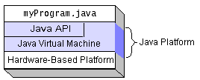
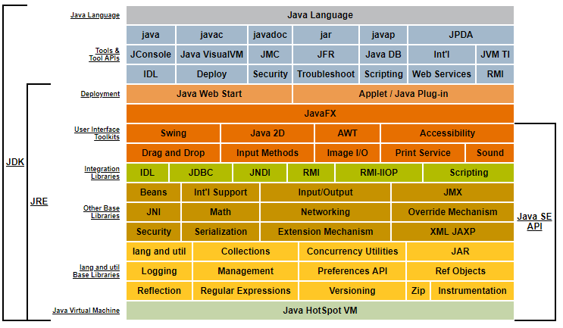
Java Platform
Notes:
JDK Alpha and Beta (1995)
JDK 1.0 (January 23, 1996)
JDK 1.1 (February 19, 1997)
J2SE 1.2 (December 8, 1998)
J2SE 1.3 (May 8, 2000)
J2SE 1.4 (February 6, 2002)
J2SE 5.0 (September 30, 2004)
Java SE 6 (December 11, 2006)
Java SE 7 (July 28, 2011)
Java SE 8 (March 18, 2014)

Slide 8
Java terminology
Java Development Kit(JDK)
A complete java development kit that includes JRE (Java Runtime Environment), compilers and various tools like JavaDoc, Java debugger etc.
In order to create, compile and run Java program you would need JDK installed on your computer.
Java Runtime Environment(JRE)
JRE is a part of JDK
When you have JRE installed on your system, you can run a java program however you won’t be able to compile it.
JRE includes JVM, browser plugins and applets support. When you only need to run a java program on your computer, you would only need JRE.

Slide 9
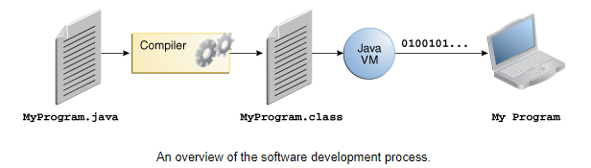
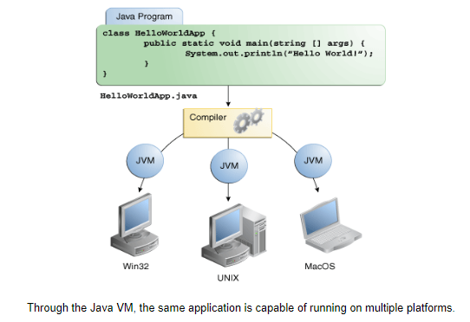
Java terminology
Java Virtual Machine (JVM)

Slide 10
Basics of a Typical Java Environment
Phase 1
Editor
Program is created in an editor and stored on disk in a file ending with .java.
Disk
Phase 2
Compiler
Disk
Compiler creates bytecodes and stores them on disk in a file ending with .class.
Primary
Memory
Phase 3
Class Loader
Class loader reads .class files containing bytecodes from disk and puts those bytecodes in memory.
Disk
.
.
.
.
.
.
Primary
Memory
Phase 4
Bytecode Verifier
Bytecode verifier confirms that all bytecodes are valid and do not violate^{[vi phạm]} Java’s security restrictions^{[giới hạn]}.
.
.
.
.
.
.
Primary
Memory
Phase 5
Interpreter
Interpreter reads bytecodes and translates them into a language that the computer can understand, possibly storing data values as the program executes.
.
.
.
.
.
.
Notes:
Machine Language: The CPU has a particular set of codes which mean different things (called an Instruction Set). Not all CPU's use the same set. The major difference is between CISC and RISC, but even inside those camps one CPU might differ from the next. So the same code might not be used in another CPU, or could mean something entirely different. This is the major reason you need to recompile for other machines. There are some other reasons too, most notably the OS might require other means of communicating with it - i.e. Windows / Linux on the same CPU doesn't work with the exact same binary executable.
Byte Code: Usually this is like a virtual CPU. Then a program written and compiled to various true CPU's machine language converts this as it runs to that CPU's instruction set.

Slide 11
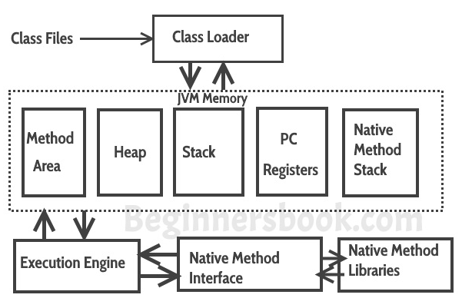
JVM Architecture

Slide 12
JVM Architecture
Class Loader: The class loader reads the .class file and save the byte code in the method area.
Method Area: There is only one method area in a JVM which is shared among all the classes. This holds the class level information of each .class file.
Heap: Heap is a part of JVM memory where objects are allocated. JVM creates a Class object for each .class file.
Stack: Stack is a also a part of JVM memory but unlike Heap, it is used for storing temporary variables.
PC Registers: This keeps the track of which instruction^{[câu} ^{lệnh]} has been executed and which one is going to be executed. Since instructions are executed by threads, each thread has a separate PC register.

Slide 13
JVM Architecture
Native Method stack: A native method can access the runtime data areas of the virtual machine.
Native Method interface: It enables java code to call or be called by native applications. Native applications are programs that are specific to the hardware and OS of a system.
Garbage collection: A class instance is explicitly created by the java code and after use it is automatically destroyed by garbage collection for memory management.

Slide 14
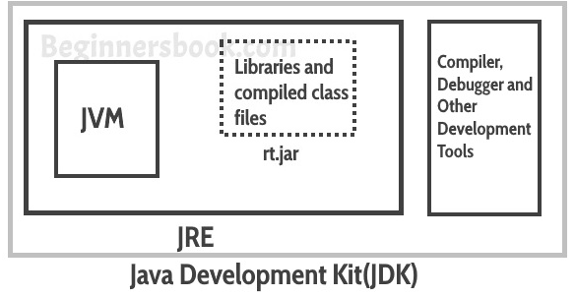
JVM
Difference JDK, JRE & JVM?
JRE: JRE is the environment within which the java virtual machine runs. JRE contains Java virtual Machine(JVM), class libraries, and other files excluding development tools such as compiler and debugger.
JVM: JVM runs the program by using class, libraries and files provided by JRE.
JDK: JDK is a superset of JRE, it contains everything that JRE has along with development tools such as compiler, debugger etc.

Slide 15
First Java Program
Section 2

Slide 16
First Sample: Printing a Line of Text
//This is a simple program called First.java
public class First {
public static void main(String[] args) {
System.out.println("My first program in Java ");
}
}
Notes:
PATH=C:\Program Files\Java\jdk1.8.0_45\bin

Slide 17
First Sample: Analyzing the Java Program
In which:
The symbol // stands for commented line.
The line class First declares a new class called First.
public static void main(String[] args)
This is the main method from where the program begins its execution.
System.out.println("My first program in Java ");
This line displays the string My first program in java on the screen.
Notes:
C:\> set path=C:\Java\jdk1.6.0_16\bin
C:\> set classpath = D:\BTJava\

Slide 18
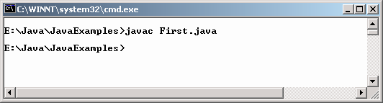
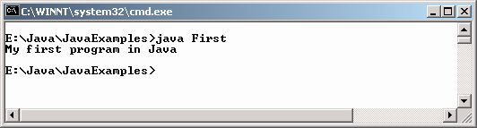
Compiling and executing
The java compiler creates a file called 'First.class' that contains the byte codes
To actually run the program, a java interpreter called java is required to execute the code.

Slide 19
Passing Command Line Arguments
public class CommLineArg {
public static void main(String[] pargs) {
System.out.
println("These are the arguments passed to the main method.");
System.out.println(pargs[0]);
System.out.println(pargs[1]);
System.out.println(pargs[2]);
}
}

Slide 20
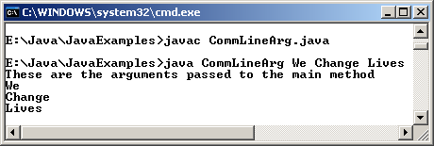
Passing Command Line Arguments

Slide 21
Basic Java Syntax
Section 3

Slide 22
Code Comment
/*
* Multi line
*/
// Single line
/**
* Special comment for Javadocs
*/
Notes:
Comment should be meaningful, not repeat the code.

Slide 23
Name Styles
In Java, names are case-insensitive, may contains letter, number, the dollar sign "$", or the underscore character "_".
Some convention name styles:
Class names: CustomerInfo
Variable, function names: basicAnnualSalary
Constants name: MAXIMUM_NUM_OF_PARTICIPANTS

Slide 24
Name Styles: Naming best practice
Name should be meaningful
Avoid very sort name, except for temporary "throwaway" variables: a, i, j
Avoid confuse name: TransferAction class and DoTransferAction class, so which one will really performs the action?
Class name should be a noun, use whole words, avoid acronyms and abbreviations: Student
Variable name should begin with a noun: numberOfFiles
Variable names should not start with underscore ('_') or dollar sign ('$') characters, even though both are allowed.
Distinguish singular - plural: Student - Students
Method name should begin with verb: countNumberOfFiles()
As clear as possible: annualSalary instead of salary
Avoid mixed-language, ex Vietnamese + English + Japanese.
Notes:
Teacher may talk more about some other best practice in naming convention
- use whole words, avoid acronyms and abbreviations: sử dụng cả từ để đặt tên định danh, tránh dùng những từ được viết tắt, nếu có thì cmt rõ ràng

Slide 25
Java Keywords
abstract | continue | for | new | switch
assert*** | default | goto* | package | synchronized
boolean | do | if | private | this
break | double | implements | protected | throw
byte | else | import | public | throws
case | enum**** | instanceof | return | transient
catch | extends | int | short | try
char | final | interface | static | void
class | finally | long | strictfp** | volatile
const* | float | native | super | while
* | not used
** | added in 1.2
*** | added in 1.4
**** | added in 5.0
true, false, and null might seem like keywords, but they are actually literals; you cannot use them as identifiers in your programs.
Notes:
Don’t use these keywords as variable names, class names, etc
jdk1.2, 1.3 and 1.4 == Java2 "platform" jdk1.5 == java 5 jdk1.6 == java 6

Slide 26
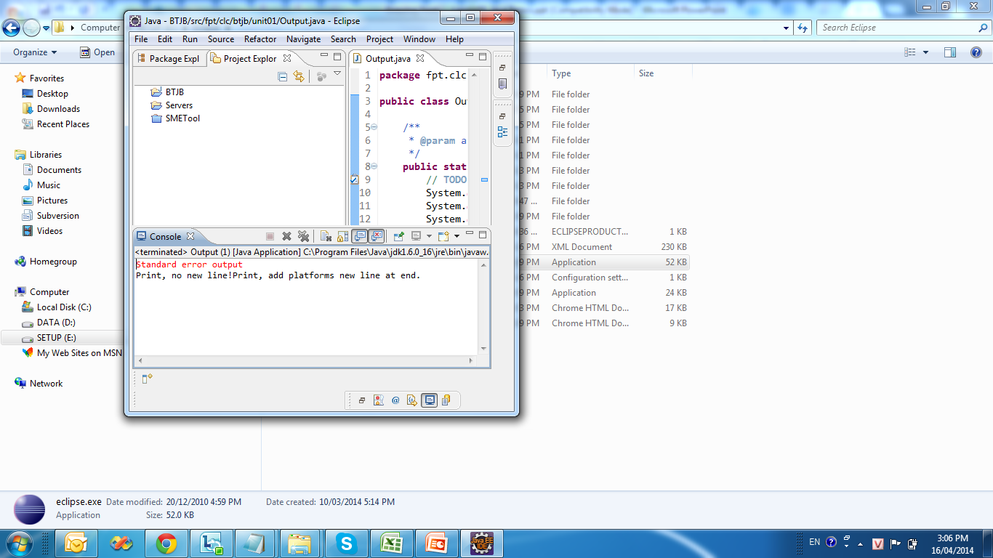
Standard Java Output
System.out is standard out in Java
System.err is error out in Java
Ex:
public class Output {
public static void main(String[] args) {
System.out.print("Print, no new line!");
System.out.println("Print, add platforms new line at end.");
System.out.flush();
System.err.println("Standard error output");
}
}

Slide 27
Standard Java Input
System.in is standard input in Java
The following program reads characters from the keyboard then print out to the screen.
public class Echo {
public static void main(String[] args) throws IOException{
int ch;
System.out.println("Enter some text: ");
while ((ch = System.in.read()) != '\n') {
System.out.print((char) ch);
}
}
}

Slide 28
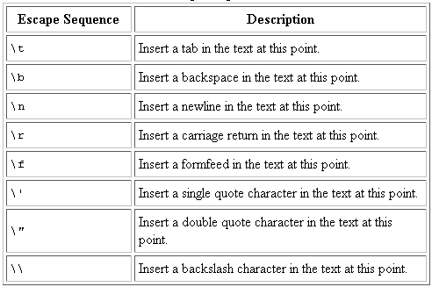
Escape characters
Escape characters is backslash ( \ )

Slide 29
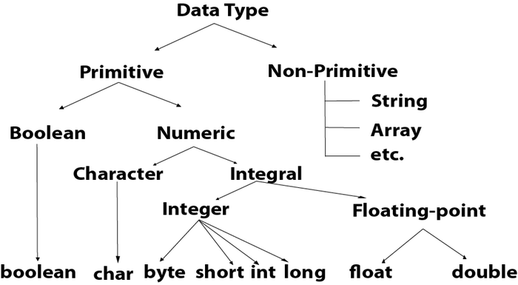
Basic Data Types

Slide 30
Basic Data Types
byte: The byte data type is an 8-bit signed two's complement integer. It has a minimum value of -128 and a maximum value of 127 (inclusive).
short: The short data type is a 16-bit signed two's complement integer. It has a minimum value of -32,768 and a maximum value of 32,767 (inclusive)
int: The int data type is a 32-bit signed two's complement integer. It has a minimum value of -2,147,483,648 and a maximum value of 2,147,483,647 (inclusive).
long: The long data type is a 64-bit signed two's complement integer. It has a minimum value of -9,223,372,036,854,775,808 and a maximum value of 9,223,372,036,854,775,807 (inclusive)
Notes:
A primitive type is predefined by the language and is named by a reserved keyword. Primitive values do not share state with other primitive values.
- inclusive: thể hiện chứa cả giá trị biên

Slide 31
Basic Data Types (2)
float: The float data type is a single-precision 32-bit IEEE 754 floating point. Its range of values is from 3.4E⁻⁴⁵ to 3.4E³⁸
double: The double data type is a double-precision 64-bit IEEE 754 floating point. Its range of values is from 1.7E⁻³²⁴ to 1.7976931348623157E³⁰⁸
boolean: The boolean data type has only two possible values: true and false. Use this data type for simple flags that track true/false conditions. This data type represents one bit of information, but its "size" isn't something that's precisely defined.
char: The char data type is a single 16-bit Unicode character. It has a minimum value of '\u0000' (or 0) and a maximum value of '\uffff' (or 65,535 inclusive).
Notes:
A primitive type is predefined by the language and is named by a reserved keyword. Primitive values do not share state with other primitive values.
https://vi.wikipedia.org/wiki/S%E1%BB%91_th%E1%BB%B1c_d%E1%BA%A5u_ph%E1%BA%A9y_%C4%91%E1%BB%99ng

Slide 32
Basic Data Types (3)
Default Values
It's not always necessary to assign a value when a field is declared
Fields that are declared but not initialized will be set to a reasonable default by the compiler
Generally speaking, this default will be zero or null, depending on the data type. However, is generally considered bad programming style.
Data Type | Default Value (for fields)
byte | 0
short | 0
int | 0
long | 0L
float | 0.0f
double | 0.0d
char | '\u0000'
String (or any object) | null
boolean | false
Notes:
For general-purpose programming, the decimal system is likely to be the only number system you'll ever use. However, if you need to use another number system, the following example shows the correct syntax. The prefix 0x indicates hexadecimal and 0b indicates binary:
// The number 26, in decimal
int decVal = 26;
// The number 26, in hexadecimal
int hexVal = 0x1a;
// The number 26, in binary
int binVal = 0b11010;

Slide 33
Operators
Section 4

Slide 34
Operators
Simple Assignment Operator
= Simple assignment operator
Arithmetic Operators
+ Additive operator
- Subtraction operator
* Multiplication operator
/ Division operator
% Remainder operator
Unary Operators
+ Unary plus operator; indicates positive value
- Unary minus operator; negates an expression
++ Increment operator; increments a value by 1
-- Decrement operator; decrements a value by 1
! Logical compliment operator; inverts the value of a boolean

Slide 35
Operators
public class ArithmeticOperator {
public static void main(String[] args) {
double number1 = 12.5, number2 = 3.5, result;
// Using addition operator
result = number1 + number2;
System.out.println("number1 + number2 = " + result);
// Using subtraction operator
result = number1 - number2;
System.out.println("number1 - number2 = " + result);
// Using multiplication operator
result = number1 * number2;
System.out.println("number1 * number2 = " + result);
// Using division operator
result = number1 / number2;
System.out.println("number1 / number2 = " + result);
// Using remainder operator
result = number1 % number2;
System.out.println("number1 % number2 = " + result);
}
}
Output:
number1 + number2 = 16.0
number1 - number2 = 9.0
number1 * number2 = 43.75
number1 / number2 = 3.5714285714285716
number1 % number2 = 2.0

Slide 36
Operators
public class UnaryOperator {
public static void main(String[] args) {
double number = 5.2;
boolean flag = false;
System.out.println("+number = " + +number);
// number is equal to 5.2 here.
System.out.println("-number = " + -number);
// number is equal to 5.2 here.
// ++number is equivalent to number = number + 1
System.out.println("number = " + ++number);
// number is equal to 6.2 here.
// -- number is equivalent to number = number - 1
System.out.println("number = " + --number);
// number is equal to 5.2 here.
System.out.println("!flag = " + !flag);
// flag is still false.
}
}
Output:
+number = 5.2
-number = -5.2
number = 6.2
number = 5.2
!flag = true

Slide 37
Operators
Equality and Relational Operators
== Equal to
!= Not equal to
> Greater than
>= Greater than or equal to
< Less than
<= Less than or equal to
Conditional Operators
&& Conditional-AND
|| Conditional-OR
?: Ternary (shorthand for if-then-else statement)
Type Comparison Operator
instanceof Compares an object to a specified type
Notes:
?: Ternary
variable x = (expression) ? value if true : value if false

Slide 38
Operators
public class RelationalOperator {
public static void main(String[] args) {
int number1 = 5, number2 = 6;
if (number1 > number2) {
System.out.println("number1 is greater than number2.");
} else {
System.out.println("number2 is greater than number1.");
}
}
}
number2 is greater than number1.
public class InstanceofOperator {
public static void main(String[] args) {
String test = "FPT";
boolean result;
result = test instanceof String;
System.out.println(result);
}
}

Slide 39
Operators
public class ConditionalOperator {
public static void main(String[] args) {
int februaryDays = 29;
String result;
result = (februaryDays == 28) ? "Not a leap year" :
"Leap year";
System.out.println(result);
}
}
Leap year

Slide 40
Operators
Bitwise and Bit Shift Operators
~ Unary bitwise complement (đảo bít)
<< Signed left shift
>> Signed right shift
>>> Unsigned right shift
& Bitwise AND
^ Bitwise exclusive OR (triệt tiêu = XOR)
| Bitwise inclusive OR

Slide 41
Operators
public class LogicalOperator {
public static void main(String[] args) {
int number1 = 1, number2 = 2, number3 = 9;
boolean result;
// At least one expression needs to be true for result to be true
result = (number1 > number2) || (number3 > number1);
// result will be true because (number1 > number2) is true
System.out.println(result);
// All expression must be true from result to be true
result = (number1 > number2) && (number3 > number1);
// result will be false because (number3 > number1) is false
System.out.println(result);
}
}
true false

Slide 42
Operators
public class BitwiseOperatorDemo {
public static void main(String args[]) {
int num1 = 11; /* 11 = 00001011 */
int num2 = 22; /* 22 = 00010110 */
int result = 0;
result = num1 & num2;
System.out.println("num1 & num2: " + result);
result = num1 | num2;
System.out.println("num1 | num2: " + result);
result = num1 ^ num2; // generates 1 if they are not equal, else it returns 0.
System.out.println("num1 ^ num2: " + result);
result = ~num1;// changes the bit from 0 to 1 and 1 to 0.
System.out.println("~num1: " + result);
result = num1 << 2;
System.out.println("num1 << 2: " + result);
result = num1 >> 2;
System.out.println("num1 >> 2: " + result);
}
}
num1 & num2: 2
num1 | num2: 31
num1 ^ num2: 29
~num1: -12
num1 << 2: 44
num1 >> 2: 2
Notes:
00001011 = 11110100 = -12 = 4+ 16 + 32 + 64-128 = -12
00001011 = 00101100 = 4+8+ 32 = 44
00001011 = 00000010 = 2

Slide 43
Operator Precedence
Operators | Precedence
postfix | expr++ expr--
unary | ++expr --expr +expr -expr ~ !
multiplicative | * / %
additive | + -
shift | << >> >>>
relational | < > <= >= instanceof
equality | == !=
bitwise AND | &
bitwise exclusive OR | ^
bitwise inclusive OR | |
logical AND | &&
logical OR | ||
ternary | ? :
assignment | = += -= *= /= %= &= ^= |= <<= >>= >>>=
Notes:
The operators in the following table are listed according to precedence order. The closer to the top of the table an operator appears, the higher its precedence. Operators with higher precedence are evaluated before operators with relatively lower precedence. Operators on the same line have equal precedence. When operators of equal precedence appear in the same expression, a rule must govern which is evaluated first. All binary operators except for the assignment operators are evaluated from left to right; assignment operators are evaluated right to left.

Slide 44
Type Casting
In type casting, a data type is converted into another data type.
Automatic Type Promotion in Expressions
Example:
public class AutomaticTypePromotion {
public static void main(String[] argv) {
byte a = 40;
byte b = 50;
byte c = 100;
int d = a * b / c;
b = b * 2; // Error! Cannot assign an int to a byte!
System.out.println("Value d: " + d);
}
}

Slide 45
Type Casting
Type casting in Expressions
Casting is used for explicit type conversion. It loses information above the magnitude of the value being converted
Example:
float f = 34.89675f;
d = (int) (f + 10);

Slide 46
Type Casting
Widening^{[an} ^{toàn/mở rộng]}conversions:
char->int
byte->short->int->long->float->double
Here are the Type Promotion Rules
All byte and short values are promoted to int type.
If one operand is long, the whole expression is promoted to long.
If one operand is float then the whole expression is promoted to float.
If one operand is double then the whole expression is promoted to double.
Notes:
* Promoted (/prəˈmoʊt/):

Slide 47
Variable and Constant
Section 5

Slide 48
Variables and constants
Variable:
Three components of a variable declaration are:
Data type
Name
Initial value to be assigned (optional)
Syntax
datatype identifier [=value][, identifier[=value]...];
Example:
int foo = 42;
double d1 = 3.14, d2 = 2 * 3.14;
boolean isFun = true;

Slide 49
Variables and constants
Constants:
It makes code more readable
It saves work when you make a change
You avoid risky^{[rủi ro]} errors
In the case of string text
Syntax
static final datatype constName = value;
Example:
static final int MAX_SECONDS = 25;
static final float PI = 3.14f;

Slide 50
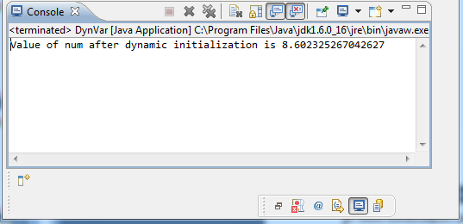
Variables and constants
Example:
public class DynVar {
public static void main(String[] args) {
// TODO Auto-generated method stub
double len = 5.0, wide = 7.0;
double num = Math.sqrt(len * len + wide * wide);
System.out.println("Value of num after dynamic initialization is " + num);
}
}

Slide 51
Scope and Lifetime of Variables
Variables can be declared inside a block.
The block begins with an opening curly brace and ends with a closing curly brace.
A block defines a scope.
A new scope is created every time a new block is created.
Scope specifies what objects are visible to other parts of the program.
It also determines the life of an object.

Slide 52
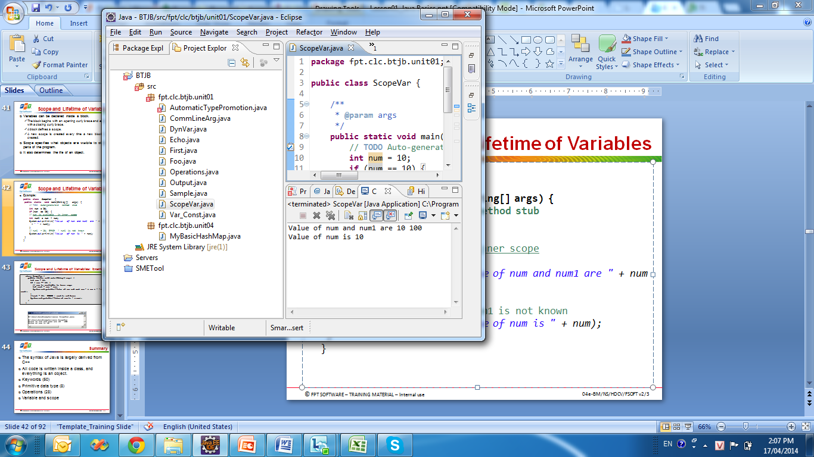
Scope and Lifetime of Variables
Example:
public class ScopeVar {
public static void main(String[] args) {
// TODO Auto-generated method stub
int num = 10;
if (num == 10) {
// num is available in inner scope
int num1 = num * num;
System.out.println("Value of num and num1 are " + num + " " + num1);
}
// num1 = 10; ERROR ! num1 is not known
System.out.println("Value of num is " + num);
}
}

Slide 53
SUMMARY
Introduction to Java
First Java Program
Basic Java Syntax
Java Data Types
Java Operators
Variables and Constant

Slide 54
Learning Approach
Strongly suggested for a better learning and understanding of this course:
Noting down the key concepts in the class
Analyze all the examples / code snippets provided
Study and understand the self study topics
Completion and submission of all the assignments, on time
Completion of the self review questions in the lab guide
Study and understand all the artifacts
Completion of the project on time inclusive of individual and group activities
Notes:
The following are strongly suggested for a better learning and understanding of this course:
Noting down the key concepts in the class
Analyze all the examples / code snippets provided
Study and understand the self study topics
Completion and submission of all the assignments, on time
Completion of the self review questions in the lab guide
Study and understand all the artifacts including the reference materials / e-learning / supplementary materials specified
Completion of the project (if application for this course) on time inclusive of individual and group activities
Taking part in the self assessment activities
Participation in the doubt clearing Sections

Slide 55

Thank you
55

